Slide 1

moneBOT
TradeBot and Stock Price Predictor
Ayushree Ghoshal 19BAI10022
Dev Singh 19BAI10093
Akshat Bhardwaj 19BAI10188
P. Yash Reddy 19BAI10190
Guide:
Dr. Nilamadhab Mishra
SCSE - spl. Artificial Intelligence and Machine Learning (B.Tech)

Slide 2
Introduction
Artificial Intelligence is an interdisciplinary branch of computer science, however, a good part of it is commercialized now as a technology. It involves computers “learning” from a massive amount of data so that they can do tasks that normally require human intervention. Computer scientists and mathematicians have conducted decades of research and development on AI.
If you are wondering why AI matters, then you only have to look at the wide range of use cases it has. A few examples of AI use cases are as follows :
Static image recognition, classification, and tagging
Automated bots for customer support
Algorithmic trading (basically through Trading Bots)
Predictive maintenance of equipment in heavy industries
Processing patient data in an efficient and scalable manner
Artificial Intelligence “trains” computer systems using algorithms so that an AI-powered system can progressively improve its performance. One such application of this outstanding branch are the Trading Bots and the Stock Price Predictor (popularly known as Algorithmic Trading and Prediction) that has made the trading life easy,organised and efficient and this is the task that we are designing in our current project.

Slide 3
Trading Bots
A little Background:
Back in 1949, Richard Dunchin came up with the concept of an automated trading system when he came up with a set of rules to buy and sell funds. Eventually, famous traders like John Henry began adopting the concept of “rule-based trading” in the 1980s. Since then, trading bots have been popular in the market in one form or another. However, these are usually pretty expensive and not available to average investors. The Bloomberg terminal can cost more than $10,000.
There are two main use-cases for trading bots. Firstly, investors can use bots to make the whole process a lot simpler and streamlined. The bots can take care of factors such as portfolio diversification, index construction, portfolio rebalancing, etc.
The second use-case is a lot more complicated and advanced. In this case, the bot will try to beat the market and consistently make profits. However, this approach requires a lot of research to be done beforehand.

Slide 4
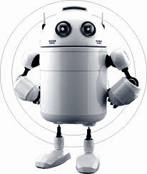
How has the world of financial trading accepted the modern intelligent solution?
Algorithmic trading has now become the norm in the foreign exchange market.
Systems that use algorithmic trading solutions make millions of trades every day.
Companies like 8topuz, hiHedge, Neotic, and Trading Depth have already made a mark in the world of trading with their AI-powered algorithmic trading solutions.
In Today's World ,algorithmic trading, businesses use computer algorithms to make trading decisions automatically. Algorithmic trading software can submit orders and manage these orders post-submission.Such software might use structured or unstructured data, alternatively, they may use both. Algorithmic trading systems have models, which are representations of the world of financial trading.

Slide 5
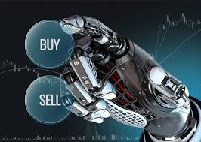
Stock Price Predictor
Accurate prediction of stock market returns is a very challenging task due to volatile and non-linear nature of the financial stock markets. With the introduction of artificial intelligence and increased computational capabilities, programmed methods of prediction have proved to be more efficient in predicting stock prices. In this work, Artificial Neural Network and Random Forest techniques have been utilized for predicting the next day closing price for five companies belonging to different sectors of operation. The financial data: Open, High, Low and Close prices of stock are used for creating new variables which are used as inputs to the model.

Slide 6
Existing Work
There are different kinds of Trading Bots in the Market :
Arbitrage
Arbitrage strategy entails simultaneously buying a coin on one exchange and selling it on another. For example, if a bot notices LTC selling for $300 on Bittrex and for $312 on Coinbase Pro, the bot will buy LTC on the exchange where it’s cheaper and sell it on the other exchange for a profit. In the beginning of the cryptocurrency market, this was one of the first strategies crypto traders utilized to make quick, safe profits.
Market Making
Market makers both buy and sell a token in order to help the market discover a price. The advantage of market making is that it can help prevent large swings in price.This can involve making both buy and sell limit orders near the existing market price, and as prices fluctuate, the trading bot will automatically and continuously place limit orders in order to profit from the spread. Many market making bot traders are actually affiliated with the projects they’re trading.

Slide 7
Presently we have crypto trading Bots (work for cryptocurrency) that are operating in the market and have a huge demand.
The best FREE crypto trading bots :
Blackbird Bitcoin Arbitrage
Blackbird is a unique bitcoin trading bot that utilizes arbitrage deals. Arbitrage bots come with the advantage of not selling tokens that you own but rather looking to utilize the arbitrage strategy to find gaps in the market and take advantage of them.
Catalyst Enigma
Catalyst is a bot built using the Python programming language. A major benefit of using Catalyst is that it's heavily customizable . Developers can build and test complex custom strategies and analyze them on Enigma's dashboard, which provides a number of valuable metrics about each strategy. Users can then share this data with other users and compare notes on which strategies are the most valuable.

Slide 8
ZenBot
ZenBot is another bot service we would recommend to first time users. It has advanced features including paper trading to test strategies in real-time, configurable order types, and a flexible sample period and trade frequency. Although the platform has not had as much maintenance as we would have hoped up to this point, there is a way to download and modify the code if needed..
The best PAID crypto trading bots are :
Shrimpy - Unlike the other bots on this list so far, It costs money to use and for good reason. Shrimpy offers a number of advanced features including a focus on portfolio management, portfolio rebalancing and cross exchange performance monitoring.
Haasbot - It is a more advanced bot, reflected in its price starting at $254 per year
3Commas- It is a more advanced trading bot with a number of sophisticated trading options built in. While it may have similar features to Haasbot, there is one key feature that stands out: the ability to backtest trade strategies on other portfolios. This can give you some insight on the strategies of the platform’s most successful users, essentially allowing you to copy their strategies, see how they work, and possibly build on top of them.

Slide 9
Limitations
Mechanical failures
If an internet connection is lost, an order might not be sent to the market. There could also be a discrepancy between the "theoretical trades" generated by the strategy and the order entry platform component that turns them into real trades.
MONITORING
It is possible for an automated trading system to experience anomalies that could result in errant orders, missing orders or duplicate orders. If the system is monitored, these events can be identified and resolved quickly

Slide 10
OVER OPTIMIZATION
Traders who employ backtesting techniques can create systems that look great on paper and perform terribly in a live market. Over-optimization refers to excessive curve-fitting that produces a trading plan unreliable in live trading.
BOTTOM LINE
Although appealing for a variety of reasons, automated trading systems should not be considered a substitute for carefully executed trading. Technology failures can happen, and as such, these systems do require monitoring. Server-based platforms may provide a solution for traders wishing to minimize the risks of mechanical failures. Remember, you should have some trading experience and knowledge before you decide to use automated trading systems

Slide 11
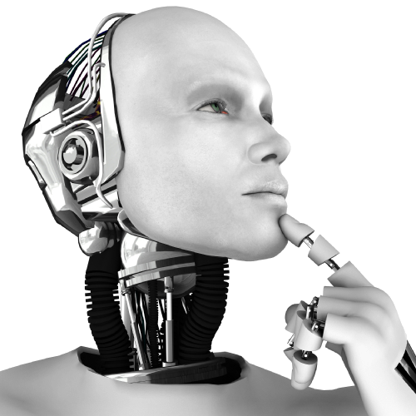
Objective
TRADING BOT’s objective is to automate actions that are either too complex, time-consuming, or difficult for humans to execute manually. The sophistication of these tasks ranges from automating a single trading strategy on a single trading pair to intelligently routing trades between any asset for a diverse portfolio.
STOCK MARKET PREDICTION, the objective is to predict the future value of financial stocks of a company. The recent trend in the stock market prediction technologies is the use of machine learning which makes the prediction based on the values of the current stock market indice by training on their previous values .

Slide 12
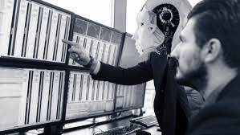
Need and Purpose
24/7 Trading
Unlike the human trader who is time restrained, a trading robot doesn’t take lunch breaks; go for frequent nature calls or sleep. In addition to this, they have no responsibilities to family and friends. This means that trading robots are able to trade for 24 straight hours, something that is impossible with human traders. This makes it possible to take advantage of the entry and exit opportunities that are available in different time sessions.

Slide 13

Need and Purpose
Trading Robots Are Quick To Act on Opportunities
The speed of the computer determines how fast the trading robot is able to identify an opportunity and execute it. This cannot be compared to the human trader who has to manually enter an order. This means that it would take so many great minds to achieve what a trading robot can in a single trading session.

Slide 14
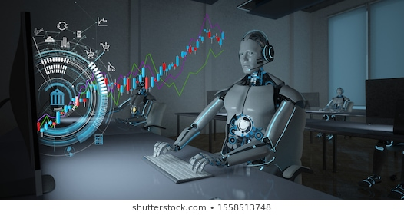
Need and Purpose
Multitasking
Trading robots are able to monitor multiple currency pairs at a go. It eliminates the physical aspect of being glued to your screen tracking your currencies. You have the power to effortlessly monitor more currencies at once.
Trading robots have now made it possible to hold and run multi-account trading fund whenever you’d wish to do so. Automated trading has made it possible for traders to overcome trading challenges that result from time limitations, speed, diligence.

Slide 15
Need and Purpose
Better, Faster and More Accurate
Stock market prediction is the act of trying to determine the future value of a company stock or other financial instrument traded on an exchange. The successful prediction of a stock's future price could yield significant profit. The efficient-market hypothesis suggests that stock prices reflect all currently available information and any price changes that are not based on newly revealed information thus are inherently unpredictable. Others disagree and those with this viewpoint possess myriad
Prediction methodologies fall into three broad categories which can (and often do) overlap. They are fundamental analysis, technical analysis (charting) and technological methods.

Slide 16
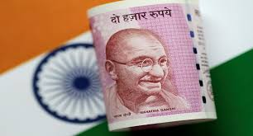

Novelty
Trade Bots which are already present in the market do not usually trade stocks in INR, those who do are quite expensive. This gives moneBOT a head-start in Indian Stock Market making it one of the few trading bots being deployed to trade stocks in INR.
Real Time Usage
Trading bots are used for real time buying and selling of stocks for a profit for the user. These are used to reduce the manual computing of patterns in the charts to benefit the user.

Slide 17
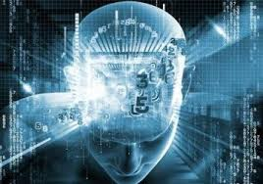
Proposed Work and Methodology
Proposed Work:
Trading bot which gathers information from the market and buys and sell stock on behalf of the user to gain a profit and conserve time.
Trading bots work by reacting to the market. They gather the data which is needed for the trade execution based on analysis of the trading platform. But stock trading platform can tell only the “half of the story” because many rises and falls are being based on other sources that cannot be programmed into any bot for analysis. This might serve as a limitation.

Slide 18
Steps To Be Followed
Mentioned below are the steps that are required to be followed to design our product.
Step 1: To choose a language to write code for the bot
Some languages like Python could be helpful if you want to later expand your bot to use Machine Learning, for example, but the main goal here is that you pick a language you’re comfortable with
Step 2: To choose a platform on which to make the trade bot
There are various platforms to choose from when working on the trading bot like Quantopian, QuantConnect, Backtrader. To choose from these platforms becomes a necessity as per the usage of the bot.

Slide 19
Steps To Be Followed
Step 3: Choosing servers and APIs
You need a server to send requests to the exchange’s API. For testing purposes, you can obviously run the server from your own computer. However, if you want your bot to be operating constantly, your computer is definitely not a good choice.
Step 4: Understanding the basic concepts of a trading bot
When building a trading bot one should know the workarounds of such a sophisticated system. The bot basically acts one the users behalf to trade and gain substantial profits and save time.

Slide 20
Steps To Be Followed
Step 5: Getting hold of some knowledge in the stock markets
To make an optimized trading bot one needs much information about the works of a stock market without this crucial aspect we cannot optimize our bot.
Step 6: Understanding objective and capabilities of the bot
This is also one of the most crucial aspects of our bot as the user should be clear about what can it do and what the bot is made to do. One of the main objectives of the trade bot is to gain profit and save time.
Step 7: Coding
Goal in this should be to keep the code simple and concise so that it is easier to optimize and traverse. While building the bot make sure that the correct servers and APIs are used with all the databases (historical and live) are installed and good decision making flow is implemented.

Slide 21
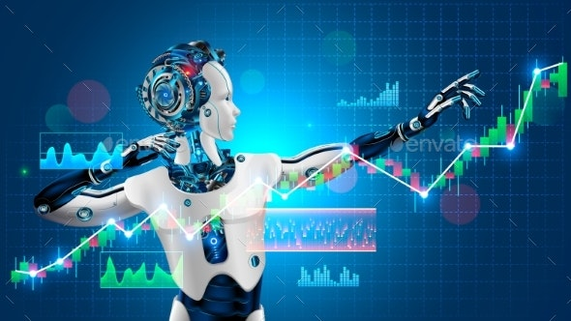
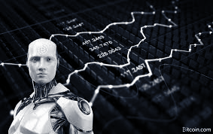
Steps To Be Followed
Step 8: Optimizing the bot
Keeping logs is a fantastic way to keep your bot updated any kind of errors can be identified easily by the timestamps in the log file. Also identifying trends in the charts is one of the goals for a good trade bot as it should buy at a low price and sell and high price.

Slide 22
Hardware and Software Requirements (Windows)
Recommended hardware specifications are:
Quad-core processor (2.0 GHz and up)
4 GB memory and up
Stable wired internet connection (minimum 5mbit download)
Minimum software specifications on Microsoft Windows
Windows Vista, 7, 8 or 8.1 and 10 (32-bit and 64-bit)
Windows Server 2003 SP2 and newer
Microsoft .NET 4.5.2
Recommended software are:
NetTime

Slide 23
Hardware and Software Requirements (MacOS)
Recommended hardware specifications are:
Quad-core processor (2.0 GHz and up)
4 GB memory and up
Stable wired internet connection (minimum 5mbit download)
Required software specifications on MacOS:
Mono framework

Slide 24
Hardware and Software Requirements (LINUX)
Recommended hardware specifications are:
Quad-core processor (2.0 GHz and up)
4 GB memory and up
Stable wired internet connection (minimum 5mbit download)
Required software specifications on Linux:
Mono framework

Slide 25
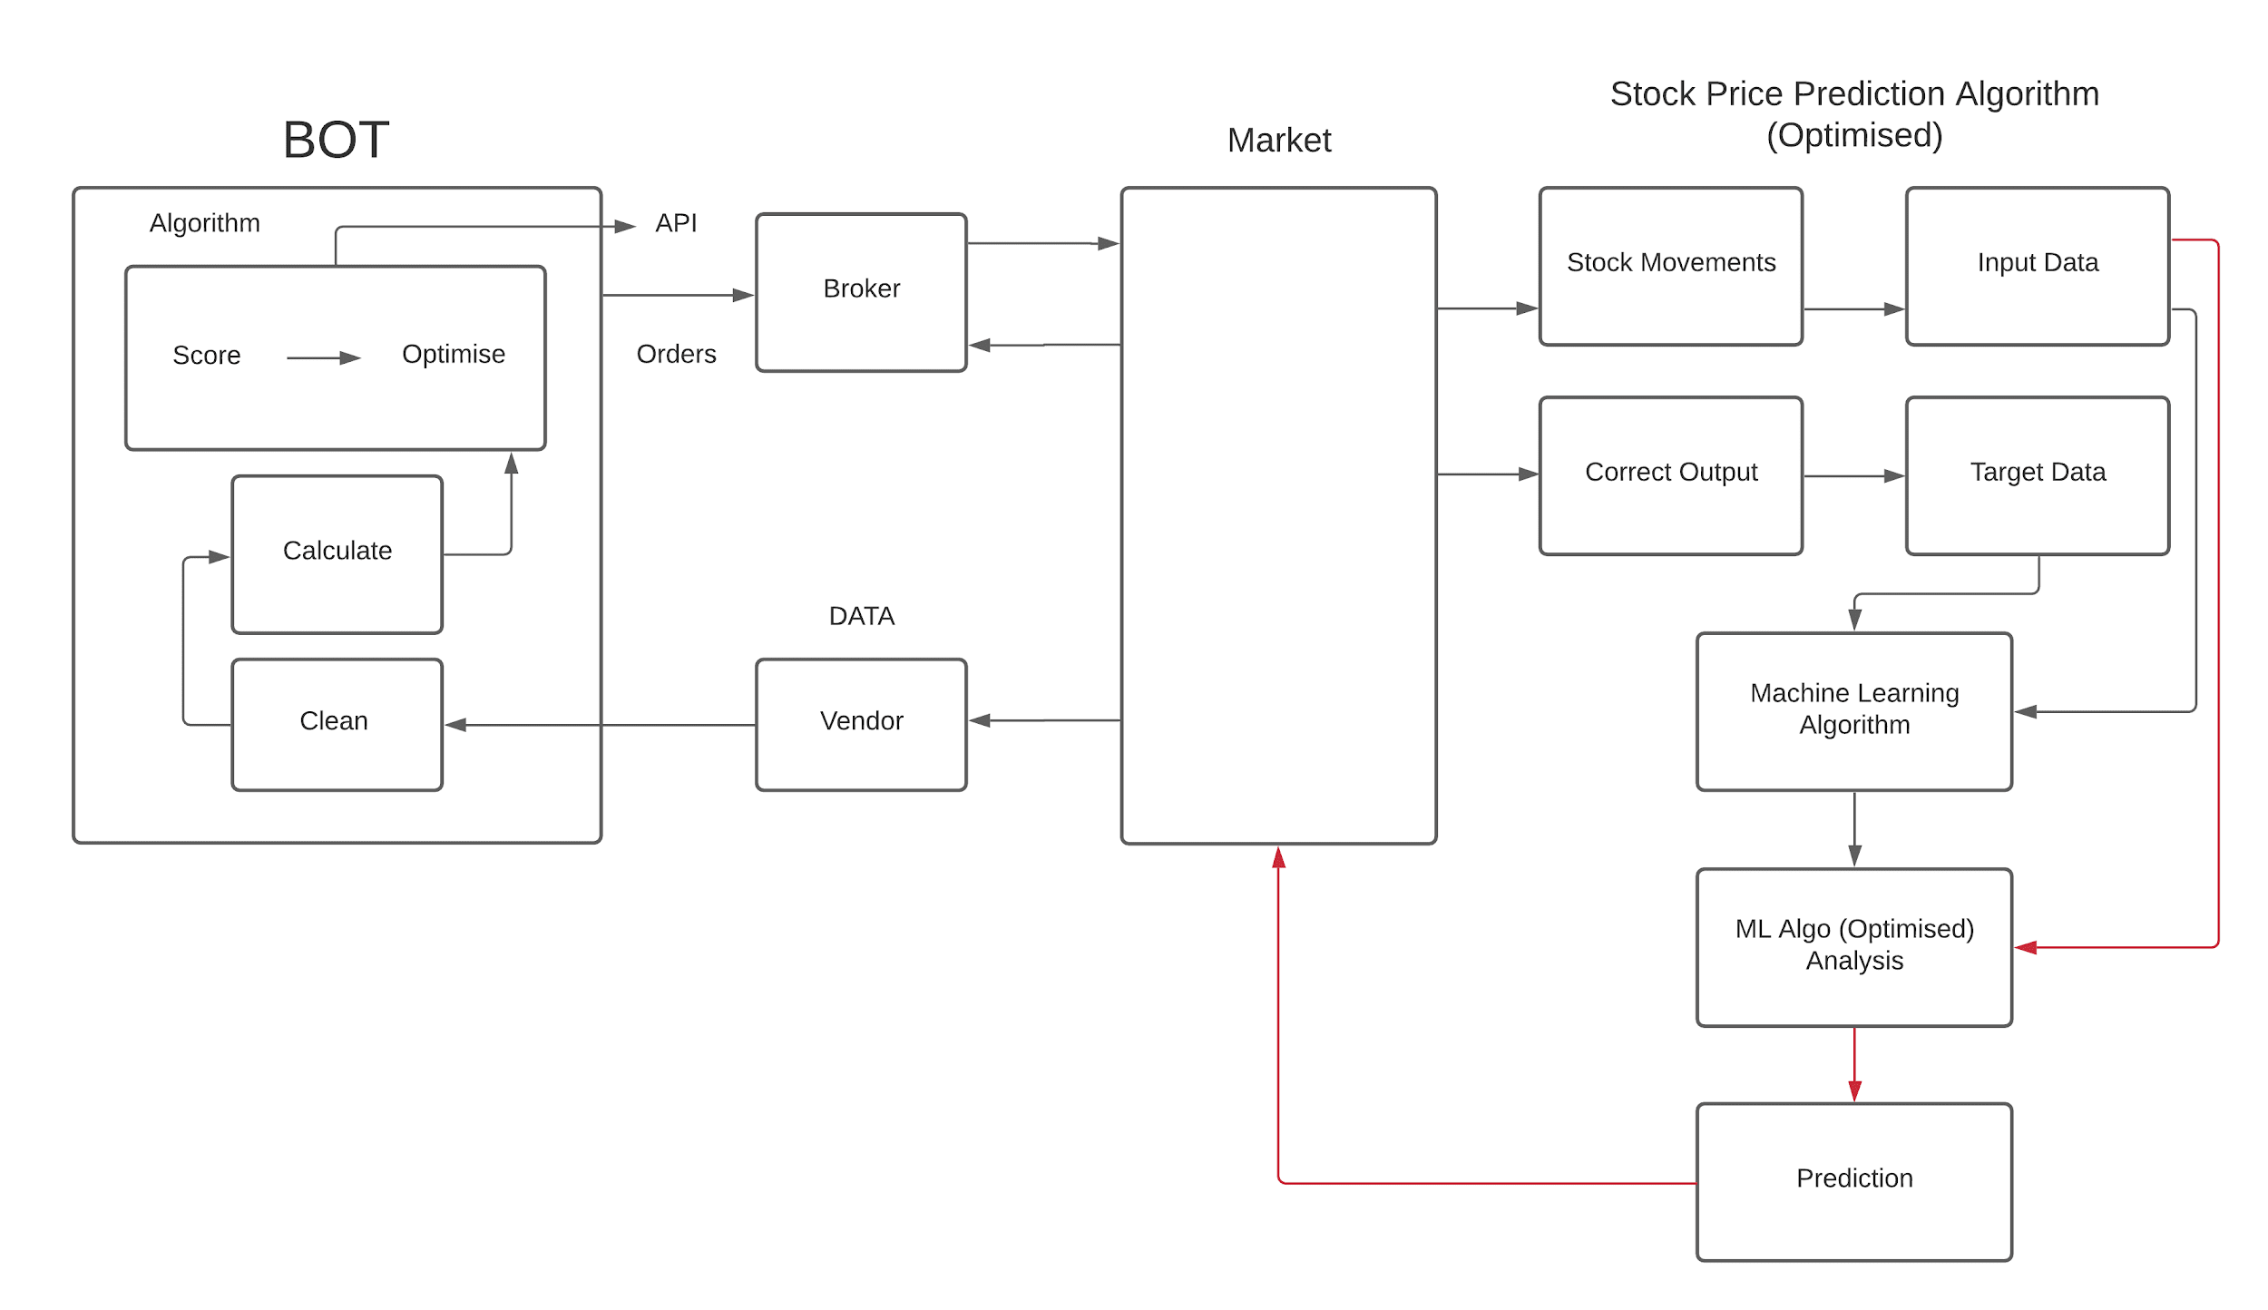
System Architecture Diagram

Slide 26
Literature Review
There are many related researches on stock price prediction. Support vector machines was applied to build a regression model of historical stock data and to predict the trend of stock. Particle swarm optimization algorithm is used to optimize the parameters of support vector machine, which can predict the stock value robustly. This study improves the support vector machine method, but particle swarm optimization algorithm requires a long time to calculate. LSTM was combined with naive Bayesian method to extract market emotion factors to improve the performance of prediction. This method can be used to predict financial markets in completely different time scales with other variables. The emotional analysis model integrated with the LSTM time series learning model to obtain a robust time series model for predicting the opening price of stocks, and the results showed that this model could improve the accuracy of prediction.

Slide 27
Real-time wavelet denoising was combined with LSTM network to predict the east Asian stock index, which corrected some logic defects in previous studies. Compared with the original LSTM, this combination model is greatly improved with high prediction accuracy and small regression error. Bagging method was used to combine multiple neural network method to predict Chinese stock index (including the Shanghai composite index and Shenzhen component index), each neural network was trained by back propagation method and Adam optimization algorithm, the results show that the method has different accuracy for prediction of different stock index, but the prediction on close is unsatisfactory. The evolutionary method was applied to predict the change trend of stock price. The deep belief network with inherent plasticity was used to predict the stock price time series. Convolutional neural network was applied to predict the trend of stock price. A forward multi-layer neural network model was created for future stock price prediction by using a hybrid method combining technical analysis variables and basic analysis variables of stock market indicators and BP algorithm. The results show that this method has higher accuracy in predicting daily stock price than the technical analysis method.

Slide 28
An effective soft computing technology was designed for Dhaka Stock Exchange (DSE) to predict the closing price of DSE. The comparison experiment with artificial neural network and adaptive neural fuzzy reasoning system shows that this method is more effective. Artificial bee colony algorithm was combined with wavelet transforms and recurrent neural network for stock price forecasting.
Many international stock indices were simulated for evaluation, including the Dow Jones industrial average (DJIA), London FTSE 100 index (FTSE), Tokyo Nikkei-225 index (Nikkei) and the Taiwan stock exchange Capitalization Weighted Stock Index (TAIEX). The simulation results show that the system has good prediction performance and can be applied to real-time trading system of stock prediction.

Slide 29
Module Description
Stock market has received widespread attention from investors. It has always been a hot spot for investors and investment companies to grasp the change regularity of the stock market and predict its trend. Currently, there are many methods for stock price prediction. The prediction methods can be roughly divided into two categories: statistical methods and artificial intelligence methods.
Statistical methods include logistic regression model, ARCH model, etc.Artificial intelligence methods include multi-layer perceptron, convolutional neural network, naive Bayes network, back propagation network, single-layer LSTM, support vector machine, recurrent neural network, etc. But these studies predict only one single value. In order to predict multiple values in one model, it need to design a model which can handle multiple inputs and produces multiple associated output values at the same time. For this purpose, it is proposed an associated deep recurrent neural network model with multiple inputs and multiple outputs based on long short-term memory network. The associated network model can predict the opening price, the lowest price and the highest price of a stock simultaneously. The associated network model was compared with LSTM network model and deep recurrent neural network model.

Slide 30
MODULE WORK FLOW EXPLANATION along with IMPLEMENTATION and CODING
The art of predicting stocks has been a difficult task and even investors & researchers are highly interested in this areas development. For a good investment a future prediction of the market is necessary.
This is the model on predictions of Stock using ML. In this work we present a RNN and LSTM (long short term memory) approach to predict Stock Market. As they have proved to be one of the most successful in predicting values.

Slide 31
STEP 1: RAW DATA
Historical stock data is collected and this is used for prediction of future stock prices.
Importing the libraries
import numpy as np – numpy so that we can apply mathematical function and operations to our multidimensional arrays.
import matplotlib.pyplot as plt -for visualisation purposes.
import pandas as pd – a data analysis and manipulation tool.
import datetime – library to work with data as data objects.
Reading the dataset using.
dataset=pd.read_csv('/content/Google_Stock_Price_Train.csv',index_col="Date",parse_dates=True)
Display the dataset. The head function gives us the top 5 rows present in the set. The tail gives us the last 5 rows present in the dataset. dataset.head()

Slide 32
dataset.isna().any()this function is used to check if any data is applicable or not. It detects any missing values or NA values.
dataset.info()this basically prints the basic info. The 5 columns(head or tail assigned above) , number of non null values and data type and memory usage.
dataset["Volume"] = dataset["Volume"].str.replace(',', '').astype(floa)this function has been written to homogenise the datatype of the column types as we see the data type is object while the others are float.
The next function involves taking out the 7 DAY ROLLING MEAN. For every single stock prediction, we require to look 7 days back collect all transactions that fall in that range and find out the average.dataset. rolling(7). mean().head()
The next step would involve comparisons of the previous graphs with the rolling mean.Lastly in this step we are creating our training dataset and reading using pandas.

Slide 33
STEP 2 : DATA PREPROCESSING
It involves data discretization (reduce a part by keeping particular parts), Data transformation(normalise), Data cleaning (fill in missing values) and data integration. After it is divided into a clean data set it is divided into a training and testing sets to evaluate.
from sklearn.preprocessing import MinMaxScaler
sc = MinMaxScaler(feature_range = (0, 1))
training_set_scaled = sc.fit_transform(training_set)
here we need to sacle the data using MinMax Scaler form sklearn ( a python library )in range 0 to 1.
Next we require to create a data structure with 60 timesteps we are taking data from day 1 to day 60 and make predictions on 61st day and then follow by taking data from day 2 to day 61 and predict the 62nd day.
X_train = [] y_train = []

Slide 34
a loop from i=60 to the end and the we append the x train[]- starts from i-60 so i=61 then its 1 thus it starts from the 1st day and ends at 61. and y train [] – gives the prediction on the I th day (61st)
for i in range(60, 1258):
X_train.append(training_set_scaled[i-60:i, 0])
y_train.append(training_set_scaled[i, 0])
X_train, y_train = np.array(X_train), np.array(y_train)
The next thing to be done is to reshape the data.
X_train = np.reshape(X_train, (X_train.shape[0], X_train.shape[1], 1))

Slide 35
STEP 3: FEATURE EXTRACTION
In this we are going to extract the features to be fed by the Neural Network from date, high, low, close and volume.
We have to import Keras library and package to build the RNN. It is actually a Tensor Flow high level APP for building and training deep earning models.
from keras.models import Sequential- linear stack of layers through which we create sequential models.
from keras.layers import Dense- this function is a regular deeply connected neural network layer commonly and frequently used to change dimensions of the output.
now We require to initialize the RNN for a time series problem we are using a regression model for that the first step is to read in the data which is a sequential data and assign it to regressor. regressor = Sequential()

Slide 36
STEP 4: TRAINING THE NEURAL NETWORK
The data is fed to the Neural Network and trained for predictions. We are going to assign weights to the model. It is followed by a Sequential Input Layer followed by three LSTM layers and a dense layer with activation and a dense output layer with linear activation function.
We require to use dropout which is regularisation technique for reducing overfitting in NN. It drops units in NN as we require only one output so units =1
regressor.add(LSTM(units = 50, return_sequences = True, input_shape = (X_train.shape[1], 1)))
regressor.add(Dropout(0.2))
# Adding a second LSTM layer and some Dropout regularisation
regressor.add(LSTM(units = 50, return_sequences = True))
regressor.add(Dropout(0.2))

Slide 37
Adding a third LSTM layer and some Dropout regularisation
regressor.add(LSTM(units = 50, return_sequences = True))
regressor.add(Dropout(0.2))
# Adding a fourth LSTM layer and some Dropout regularisation
regressor.add(LSTM(units = 50))
regressor.add(Dropout(0.2))
# Adding the output layer
regressor.add(Dense(units = 1))
the next task would be to compile the RNN and use optimizer(one of the two arguments required to compile the Keras model). The type of optimizer can greatly affect how fast the algorithm converges the minimum value.
We have used ADAM optimizer which combines the perks of ADAgrad and RMSprop.

Slide 38
# Compiling the RNN
regressor.compile(optimizer = 'adam', loss = 'mean_squared_error')
while training we must be sure that the weights don’t get too large(focusing on one datapoint hence overfitting. We use Dropouts a new method for preventing overfitting.
OUTPUT GENERATION
On running and fitting the training set we have assigned value to epoch (a frame of time in ML) batchsize (refers the number of training examples)
# Fitting the RNN to the Training set
regressor.fit(X_train, y_train, epochs = 100, batch_size = 32)

Slide 39
STEP 5: Repeat the same for the test data and thus visualise the results.
Visualising the results
plt.plot(real_stock_price, color = 'red', label = 'Real Google Stock Price')
plt.plot(predicted_stock_price, color = 'blue', label = 'Predicted Google Stock Price')
plt.title('Google Stock Price Prediction')
plt.xlabel('Time')
plt.ylabel('Google Stock Price')
plt.legend()
plt.show()

Slide 40
THANK YOU !

